Slide 1


K.RAMAKRISHNAN COLLEGE OF TECHNOLOGY (AUTONOMOUS), TRICHY
EXTRACTING USEFUL INFORMATION FROM A DATASET OF MOVIES
PRESENTED BY
PRIYADHARSHINI J – 2303811724322085

Slide 2
PRESENTATION OVERVIEW
Problem Identification
Objective
Proposed system
Block diagram of proposed system
R Data structures used
Advantages of Proposed system
Modules of the system

Slide 3
PRESENTATION OVERVIEW
Modules Description
Modules Implementation
Source Code
Results
Conclusion

Slide 4
PROBLEM IDENTIFICATION
Movie datasets contain missing values, duplicates, and inconsistent formats.
Trend analysis (genre popularity, revenue patterns) is difficult without structured tools.
Manual analysis is time-consuming and error-prone.
Need an automated approach to process, visualize, and analyze movie data.

Slide 5
OBJECTIVE
Analyze Movie Datasets to identify patterns in audience preferences and revenue trends.
Predict Box Office Success using R data structures and libraries.
Develop an Automated System to process and analyze movie data efficiently.
Visualize Key Insights using charts and graphs to improve decision-making in movie production and marketing.

Slide 6
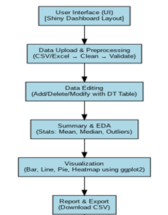
PROPOSED SYSTEM
BLOCK DIAGRAM

Slide 7
R DATA STRUCTURES USED
1. Data Frame (data.frame)
Stores movie dataset (Title, Genre, Year, Revenue).
Used in data manipulation, visualization, and exporting.
2. Reactive Values (reactiveVal())
Enables real-time data updates when users edit the dataset.
3. Character & Numeric Vectors (character(), numeric())
Character Vectors: Store genres, column names, chart types.
Numeric Vectors: Store Revenue & Year data for analysis.

Slide 8
R DATA STRUCTURES USED
4. Lists (list())
Used for export functions (CSV/PDF downloads).
5. Tables (table())
Aggregates categorical data (e.g., Genre counts for pie charts).

Slide 9
ADVANTAGES OF PROPOSED SYSTEM
Automated Data Processing – Reduces manual effort.
Interactive & Customizable – Users can edit and explore data easily.
Real-Time Insights – Generates instant reports and visualizations.
Export & Share Data – Allows saving results in CSV format & Enabled publishing of the insights.

Slide 10
MODULES OF THE SYSTEM
Data Upload & Preprocessing Module
Data Editing Module
Summary & EDA Module
Visualization Module
Report & Export Module
UI & Dashboard Module

Slide 11
MODULES DESCRIPTION
Data Upload & Preprocessing Module – Uploads CSV files, cleans data, and handles missing values.
Data Editing Module – Allows users to add, delete, and modify records dynamically.
Summary & EDA Module – Computes key statistics and detects trends/outliers.

Slide 12
MODULES DESCRIPTION
Visualization Module – Generates interactive bar charts, line graphs, pie charts, and heatmaps.
Report & Export Module – Enables downloading processed data as CSV or PDF reports.
UI & Dashboard Module – Creates a user-friendly, interactive layout for easy navigation.

Slide 13
MODULES IMPLEMENTATION
Data Upload & Preprocessing Module
observeEvent(input$file, {
ext <- tools::file_ext(input$file$name)
df <- if (ext == "csv") {
read.csv(input$file$datapath, stringsAsFactors = FALSE)
} else if (ext == "xlsx") {
readxl::read_excel(input$file$datapath)
}
req(all(c("Title", "Genre", "Year", "Revenue") %in% names(df)))
movie_data(df)
updatePickerInput(session, "selectedGenre", choices = unique(df$Genre), selected = unique(df$Genre))
})

Slide 14
MODULES IMPLEMENTATION
Data Editing Module
output$editableTable <- renderDT({
datatable(movie_data(), editable = TRUE, options= list(pageLength = 10))
})
Summary & EDA Module
output$summaryOutput <- renderPrint({
summary(movie_data())
})

Slide 15
MODULES IMPLEMENTATION
Visualization Module
output$chartOutput <- renderPlot({
df <- movie_data()
if (!is.null(input$selectedGenre)) {
df <- df[df$Genre %in% input$selectedGenre, ]
}
if (input$chartType == "Bar Chart") {
ggplot(df, aes(x = Genre, fill = Genre)) +
geom_bar() + theme_minimal()
} else if (input$chartType == "Line Chart") {
ggplot(df, aes(x = Year, y = Revenue, color = Genre)) +
geom_line() + theme_minimal()
} else if (input$chartType == "Pie Chart") {
pie(table(df$Genre), col = rainbow(length(unique(df$Genre))))
} else if (input$chartType == "Heatmap") {
ggplot(df, aes(x = Genre, y = Year, fill = Revenue)) +
geom_tile(color = "white") + theme_minimal()
}
})

Slide 16
MODULES IMPLEMENTATION
Report & Export Module
output$downloadCSV <- downloadHandler(
filename = function() { "movie_data_export.csv" },
content = function(file) {
write.csv(movie_data(), file, row.names = FALSE)
}
)

Slide 17
MODULES IMPLEMENTATION
UI & Dashboard Module
useShinyjs(),
theme = bs_theme(bootswatch = "cosmo"),
tabItems(
tabItem(tabName = "upload",
fileInput("file", "Upload CSV/Excel"), DTOutput("editableTable")),
tabItem(tabName = "summary",
verbatimTextOutput("summaryOutput")),
tabItem(tabName = "charts",
selectInput("chartType", "Chart Type", choices = c("Bar Chart", "Line Chart", "Pie Chart", "Heatmap")),
pickerInput("selectedGenre", "Filter by Genre", choices = NULL, multiple = TRUE),
plotOutput("chartOutput")),
tabItem(tabName = "export",
downloadButton("downloadCSV", "📥 Download CSV"))
)
)
ui <- dashboardPage(
dashboardHeader(title = span("🎬 Amazing Movie Data App", style = "color:white")),
dashboardSidebar(
sidebarMenu(
menuItem("Upload & Edit", tabName = "upload", icon = icon("upload")),
menuItem("Summary & Stats", tabName = "summary", icon = icon("chart-line")),
menuItem("Charts", tabName = "charts", icon = icon("chart-pie")),
menuItem("Export", tabName = "export", icon = icon("file-export"))
)
),
)
dashboardBody(

Slide 18
SOURCE CODE
dashboardBody(
useShinyjs(),
theme = bs_theme(bootswatch = "cosmo"),
tabItems(
# Upload & Edit Tab
tabItem(tabName = "upload",
fluidRow(
box(width = 6, status = "primary", solidHeader = TRUE, title = "Upload Dataset",
fileInput("file", "Choose a Movie CSV/Excel File", accept = c(".csv", ".xlsx"))
),
box(width = 12, status = "warning", solidHeader = TRUE, title = "Editable Data Table",
DTOutput("editableTable"))
)
),
# Summary Tab
tabItem(tabName = "summary",
fluidRow(
box(width = 12, status = "info", solidHeader = TRUE, title = "Summary Statistics",
verbatimTextOutput("summaryOutput"))
)
),
library(shiny)
library(shinydashboard)
library(DT)
library(dplyr)
library(ggplot2)
library(bslib)
library(shinyWidgets)
library(shinyjs)
# UI Definition
ui <- dashboardPage(
dashboardHeader(title = span("🎬 Movie Dataset Analysis App", style = "color:white")),
dashboardSidebar(
sidebarMenu(
menuItem("Upload & Edit", tabName = "upload", icon = icon("upload")),
menuItem("Summary & Stats", tabName = "summary", icon = icon("chart-line")),
menuItem("Charts", tabName = "charts", icon = icon("chart-pie")),
menuItem("Export", tabName = "export", icon = icon("file-export"))
)
),

Slide 19
SOURCE CODE
tabItem(tabName = "charts", fluidRow(
box(width = 4, status = "primary", solidHeader = TRUE, title = "Chart Settings",
selectInput("chartType", "Select Chart Type",
choices = c("Bar Chart", "Line Chart", "Pie Chart", "Heatmap")),
pickerInput("selectedGenre", "Filter by Genre",
choices = NULL, multiple = TRUE, options = list(`actions-box` = TRUE))
),
box(width = 8, status = "success", solidHeader = TRUE, title = "Visualization",
plotOutput("chartOutput", height = "400px"))
)
),
tabItem(tabName = "export", fluidRow(
box(width = 6, status = "success", solidHeader = TRUE, title = "Download Your Data",
downloadButton("downloadCSV", "📥 Download as CSV")
)
)
)
)
)
)
# Server Logic
server <- function(input, output, session) {
# Reactive Data Store
movie_data <- reactiveVal(data.frame())
# Load CSV or Excel File
observeEvent(input$file, {
ext <- tools::file_ext(input$file$name)
df <- if (ext == "csv") {
read.csv(input$file$datapath)
} else if (ext == "xlsx") {
readxl::read_excel(input$file$datapath)
}
req(all(c("Title", "Genre", "Year", "Revenue") %in% colnames(df)))
movie_data(df)
updatePickerInput(session, "selectedGenre", choices = unique(df$Genre), selected = unique(df$Genre))
})

Slide 20
SOURCE CODE
# Editable Table
output$editableTable <- renderDT({
datatable(movie_data(), editable = TRUE, options = list(pageLength = 10))
})
# Summary Statistics
output$summaryOutput <- renderPrint({
summary(movie_data())
})
# Chart Rendering
output$chartOutput <- renderPlot({
df <- movie_data()
if (!is.null(input$selectedGenre)) {
df <- df[df$Genre %in% input$selectedGenre, ]
}
if (input$chartType == "Bar Chart") {
ggplot(df, aes(x = Genre, fill = Genre)) + geom_bar() + theme_minimal()
} else if (input$chartType == "Line Chart") {
ggplot(df, aes(x = Year, y = Revenue, color = Genre)) + geom_line() + theme_minimal()
} else if (input$chartType == "Pie Chart") {
pie(table(df$Genre), col = rainbow(length(unique(df$Genre))))
} else if (input$chartType == "Heatmap") {
ggplot(df, aes(x = Genre, y = Year, fill = Revenue)) +
geom_tile(color = "white") + theme_minimal()
}
})
# Download as CSV
output$downloadCSV <- downloadHandler(
filename = function() {"movie_data_export.csv"},
content = function(file) {
write.csv(movie_data(), file, row.names = FALSE)
}
)
}
# Run the App
shinyApp(ui, server)

Slide 21
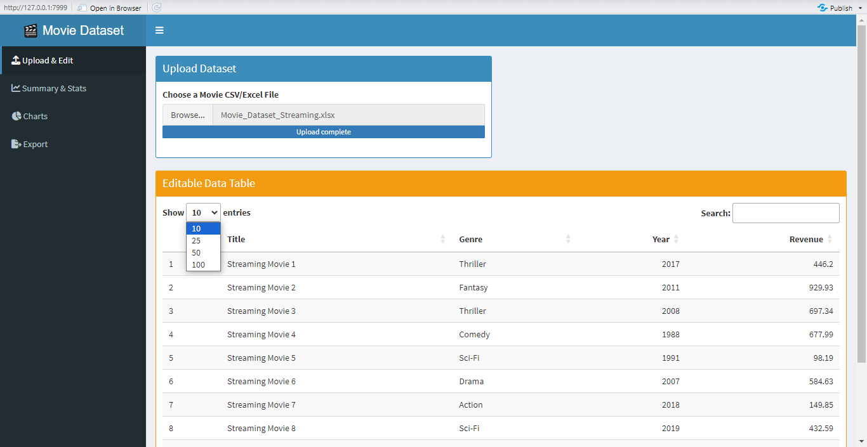
RESULTS

Slide 22
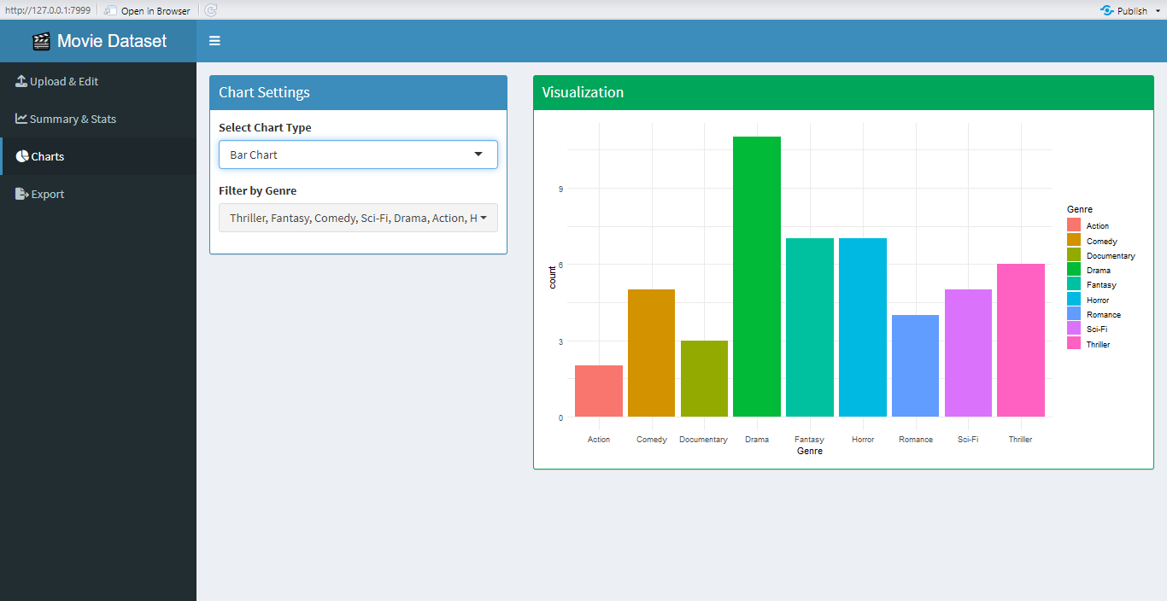
RESULTS

Slide 23
CONCLUSION
The Movie Dataset Analysis Shiny App provides a comprehensive and interactive solution for analyzing, editing, and visualizing movie data. With a clean dashboard interface, users can upload CSV/Excel files, perform exploratory data analysis, visualize trends across genres and years, and download processed datasets - all in real time.
The app enhances understanding of trends in movie genres, revenues, and release years - making it ideal for both academic and business insights.

Slide 24


